Slide 1
Microsoft Power Automate Empowerment
Notes:
Hi, Welcome to Microsoft Power Platform + Dynamics 365 Bootcamp.

Slide 2
Course Overview
Day 1
Empowering everyone with Power Platform
Day 2
Power Automate Introduction
Day 3
Power Automate Project Scenarios
Day 4
Monitoring & Administration of Power Automate
Introduction to Power Platform
Microsoft Power Platform momentum
Why Power Platform?
Customer Stories
Power Platform Components Demo
Power Platform Account Setup
Microsoft Flow Basics
Microsoft Flow Templates
Decision Making with Flow
Conditions, Switches, Scope & Context of Decision-Making Control Elements
Building Workflows with Power Automate
Hands on Lab - Microsoft Flow
Approve / Reject Workflow Scenario
User Input Acceptance & Validation Workflow Scenario
Recurrance Workflow Scenario
Dynamic 365 Integration Workflow Scenario
Azure Cognitive Services AI Integration Workflow Scenario
Power App Integration Workflow Scenario
SQL Server Integration Workflow Scenario
HoL - End to End Business Flow with all Scenarios
Import, Export Flows
Distribute Flows
Sharing of Flows across workspaces
Different Flow Environments and Code Promotion
Data Policies & Integration Check Points
Flow History and Analytics
HoL - Check your Knowledge

Slide 3
Day3: Power Automate Project Scenarios

Slide 4

Agenda
Approve / Reject Workflow Scenario
User Input Acceptance & Validation Workflow Scenario
Recurrence Workflow Scenario
Dynamic 365 Integration Workflow Scenario
Azure Cognitive Services AI Integration Workflow Scenario
Power App Integration Workflow Scenario
SQL Server Integration Workflow Scenario
HoL - End to End Business Flow with all Scenarios

Slide 5
Connectors

Slide 6























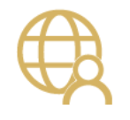




Integrate the systems you’re already using…

Slide 7
Why build a connector?
Enterprise developers
Looking for connectivity to a service we don’t currently support
Need connectivity to a custom or internal service
Partners and ISVs
Expand the number of services you integrate with
Provide the extensibility your customers need
Increase exposure and adoption

Slide 8
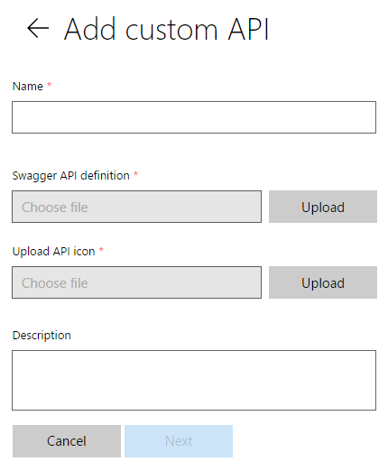
Connecting your services to PowerApps & Flow
PowerApps & Flow are fully metadata-driven and extensible so you can connect to any of your own services
Even connect to 3rd party services you consume
Custom APIs within an organization
Scoped to a company so that you can build something that’s unique to that organization
Leverage Azure functions within your apps & flows
Via custom APIs today, integrated support coming soon

Slide 9
Building a Custom Connector



Develop
Build, secure and describe your API
Import from existing artifacts (Open API, Postman) or build from scratch
Test
Validate your API calls
Use in Flow and PowerApps for E2E testing
Share
Allow other users within your organization to use your connector

Slide 10
Building a Custom Connector




Develop
Build, secure and describe your API
Import from existing artifacts (Open API, Postman) or build from scratch
Test
Validate your API calls
Use in Flow and PowerApps for E2E testing
Share
Allow other users within your organization to use your connector
Certify
Share your connector with all users of Flow and PowerApps
Only for Public Connectors

Slide 11
Custom connector architecture
Hosting environment
Connector ID
+
Operation
+
Connection ID
Host
+
Path
+
Credentials
RESTful API
Microsoft Flow
Custom connector
PowerApps

Slide 12
Using your own Web API
Hosting environment
Your
Web API
Microsoft Flow
Custom Connector
PowerApps

Slide 13
Securing your Web API
Hosting environment
AAD Application #1
AAD Application #2
Your
Web API
Microsoft Flow
Custom Connector
PowerApps

Slide 14
Connectors Demo

Slide 15












Custom Connector Resources
https://docs.microsoft.com/connectors
Custom connectors
From Postman Collection
Webhooks
Dynamic values/schema
https://aka.ms/apiconnectors
Submit for certification
Example Video : https://youtu.be/dBCS1nPsDiE
Notes:
https://www.googleapis.com/books/v1/volumes?q=search
https://www.googleapis.com/books/v1/volumes?q=ISBN:9780789748591
Gallery
First(mybooks).items
ThisItem.volumeInfo.imageLinks.thumbnail
ThisItem.volumeInfo.title
ThisItem.volumeInfo.description
Host : www.googleapis.com
Base Url: /books/

Slide 16

Demo

Slide 17
Customer Stories
Questions

Slide 19
Day 4 - Monitoring & Administration of Power Automate

Slide 20












Jenkins NS
Modern Workplace Solution Architect | Consultant
Microsoft Teams, Power Platform and SPFx Specialist
International Speaker | Blogger | Trainer
SPS Bangalore Organizer
aOS Ambassador
jenkinsns@gmail.com
in/jenkinsns
@jenkinsns
http://www.jenkinsblogs.com
jenkinsns
https://www.facebook.com/spfxinfo/
https://www.facebook.com/msteamsinfo

